Slide 1
Handwritten Digit Recognition
Department of Computer Science and Engineering
Project Title :
Submitted By :
Ritika (1810991950)
Submitted To :
Mr. Vivek bharadwaj

Slide 2
Abstract
Department of Computer Science and Engineering
A popular demonstration of the capability of deep learning techniques is object recognition in image data.
The “hello world” of object recognition for machine learning and deep learning is the MNIST dataset for handwritten digit recognition.
In this ppt you will discover how to develop a deep learning model to achieve near state of the art performance on the MNIST handwritten digit recognition task in Python using the Keras deep learning library.

Slide 3
Technology Used
Department of Computer Science and Engineering
Frontend :
HTML, CSS, Flask
Backend :
Machine Learning, CNN

Slide 4

Apps in use
Department of Computer Science and Engineering
(Currently)
Visual Studio Code Editor
google colab

Slide 5
Steps for building model
Department of Computer Science and Engineering
Data Collection
Data Preprocessing
Model Building
Model Evaluation
Model Deployment to Production

Slide 6

Data Collection
Department of Computer Science and Engineering
The MNIST database of handwritten digits, available from this page, has a training set of 60,000 examples, and a test set of 10,000 examples. It is a subset of a larger set available from NIST. The digits have been size-normalized and centered in a fixed-size image.It is a good database for people who want to try learning techniques and pattern recognition methods on real-world data while spending minimal efforts on preprocessing and formatting.

Slide 7
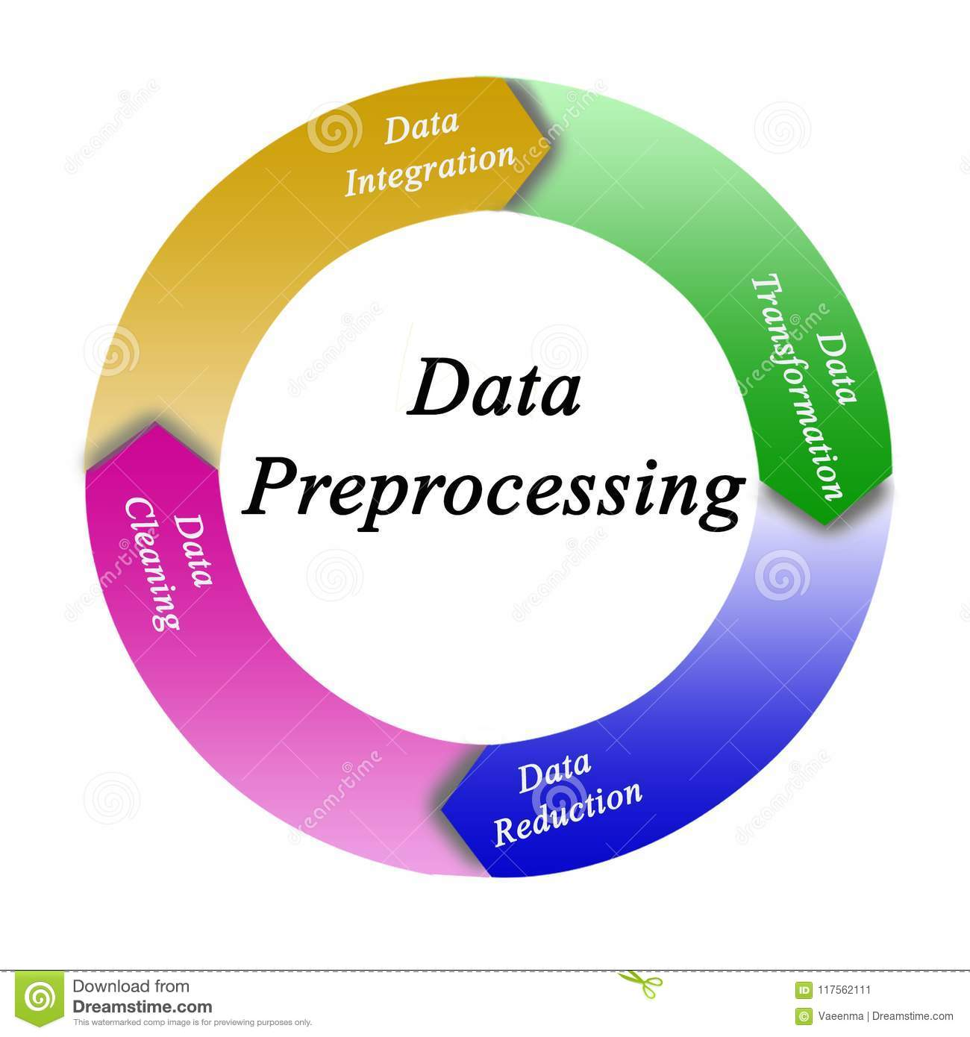
Data Pre-processing
Department of Computer Science and Engineering
The image data cannot be fed directly into the model so we need to perform some operations and process the data to make it ready for our neural network. The dimension of the training data is (60000,28,28). The CNN model will require one more dimension so we reshape the matrix to shape (60000,28,28,1).

Slide 8
Create the model
Department of Computer Science and Engineering
Now we will create our CNN model in Python data science project. A CNN model generally consists of convolutional and pooling layers. It works better for data that are represented as grid structures, this is the reason why CNN works well for image classification problems. The dropout layer is used to deactivate some of the neurons and while training, it reduces offer fitting of the model. We will then compile the model with the Adadelta optimizer.

Slide 9
Train the model
Department of Computer Science and Engineering
The model.fit() function of Keras will start the training of the model. It takes the training data, validation data, epochs, and batch size.
It takes some time to train the model. After training, we save the weights and model definition in the ‘mnist.h5’ file.

Slide 10
Evaluate the model
Department of Computer Science and Engineering
We have 10,000 images in our dataset which will be used to evaluate how good our model works. The testing data was not involved in the training of the data therefore, it is new data for our model. The MNIST dataset is well balanced so we can get around 96% accuracy.

Slide 11


Model Deployment and Production
Department of Computer Science and Engineering

Slide 12
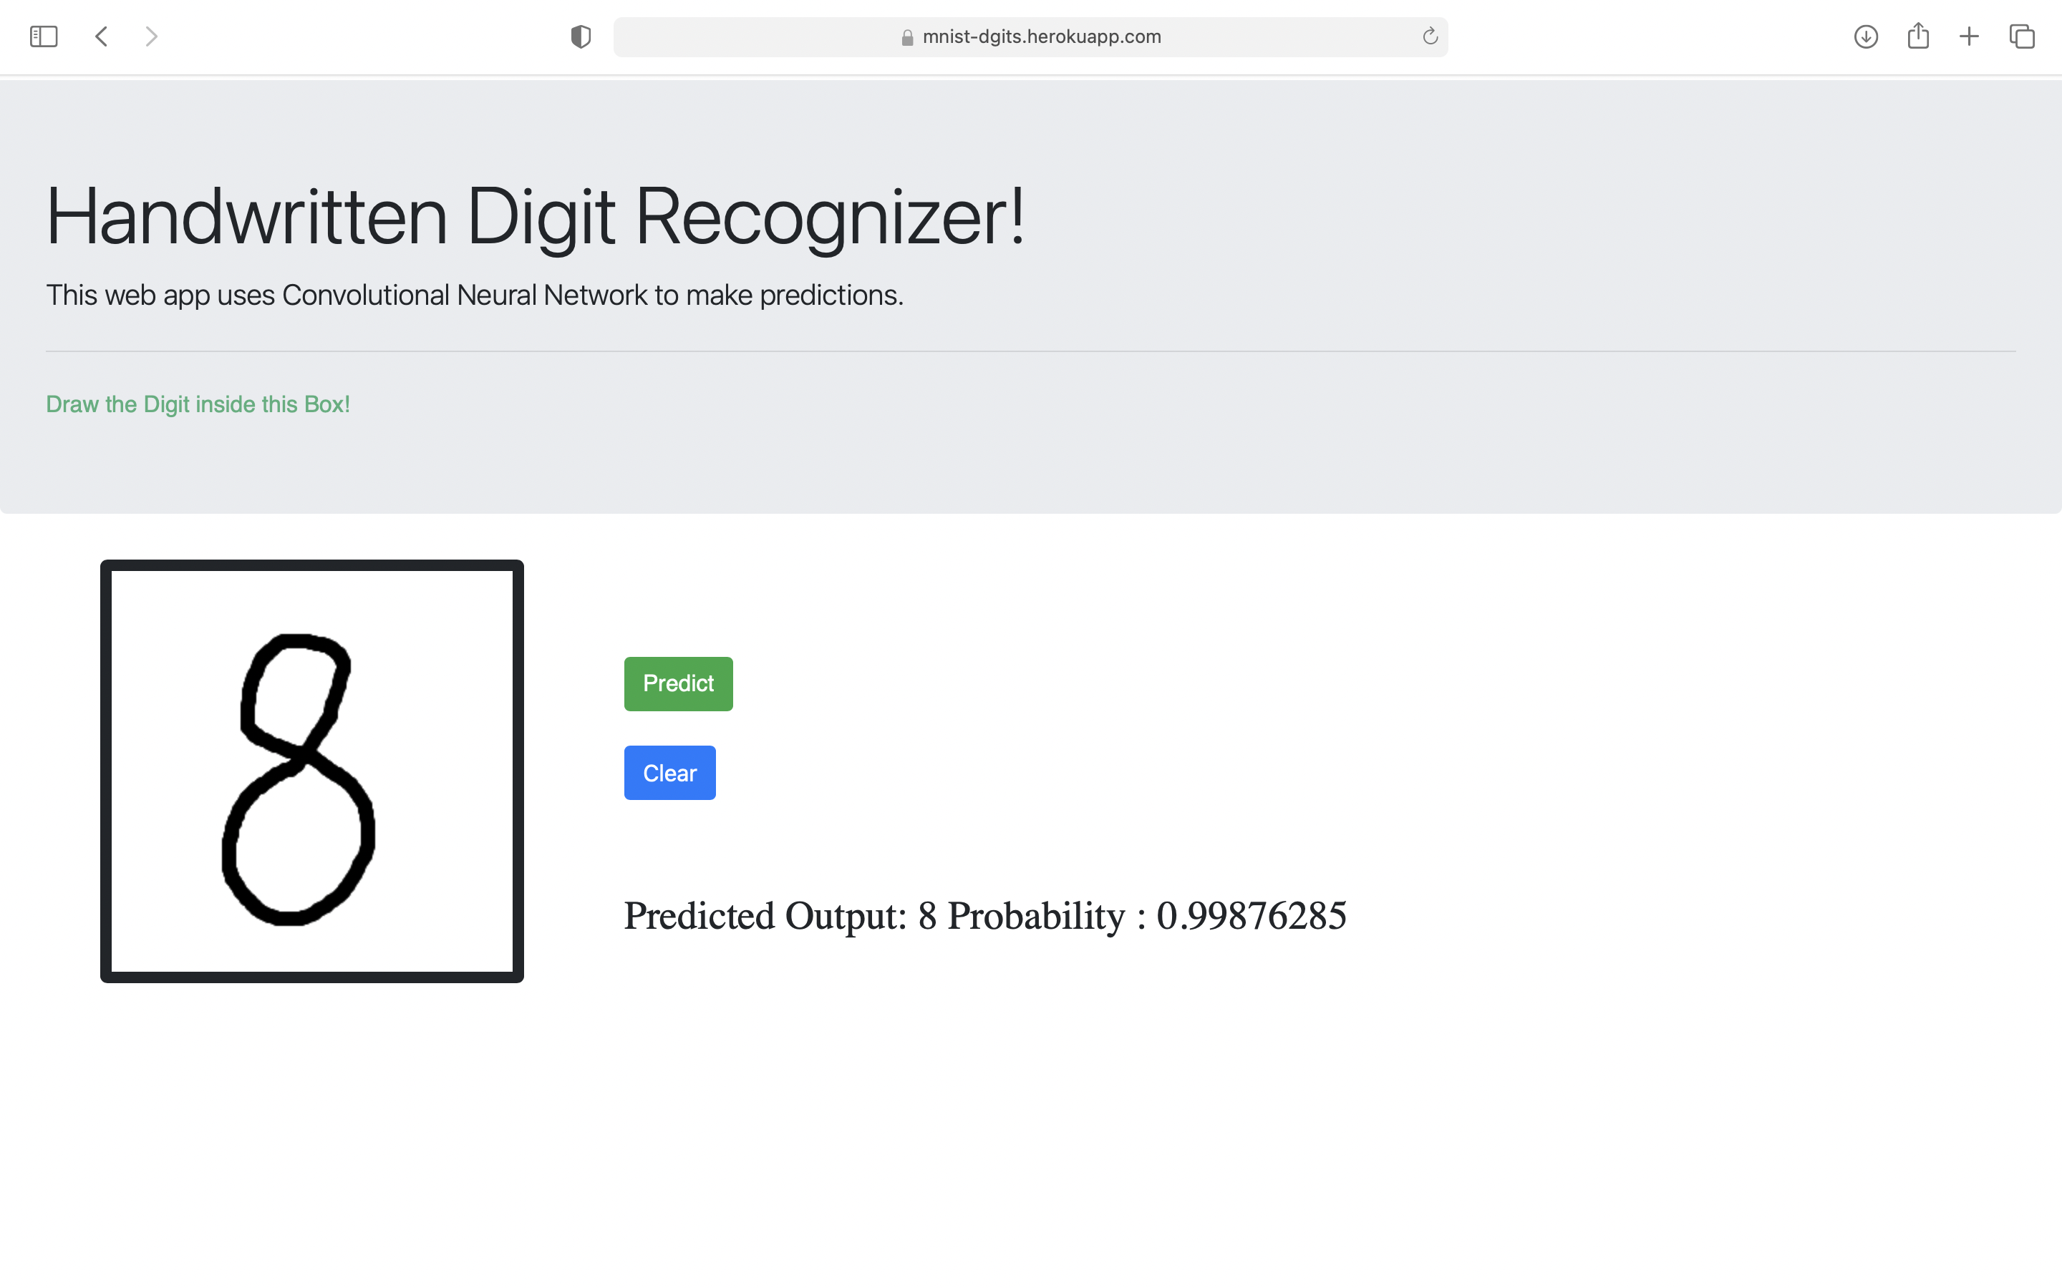
Department of Computer Science and Engineering

Slide 13
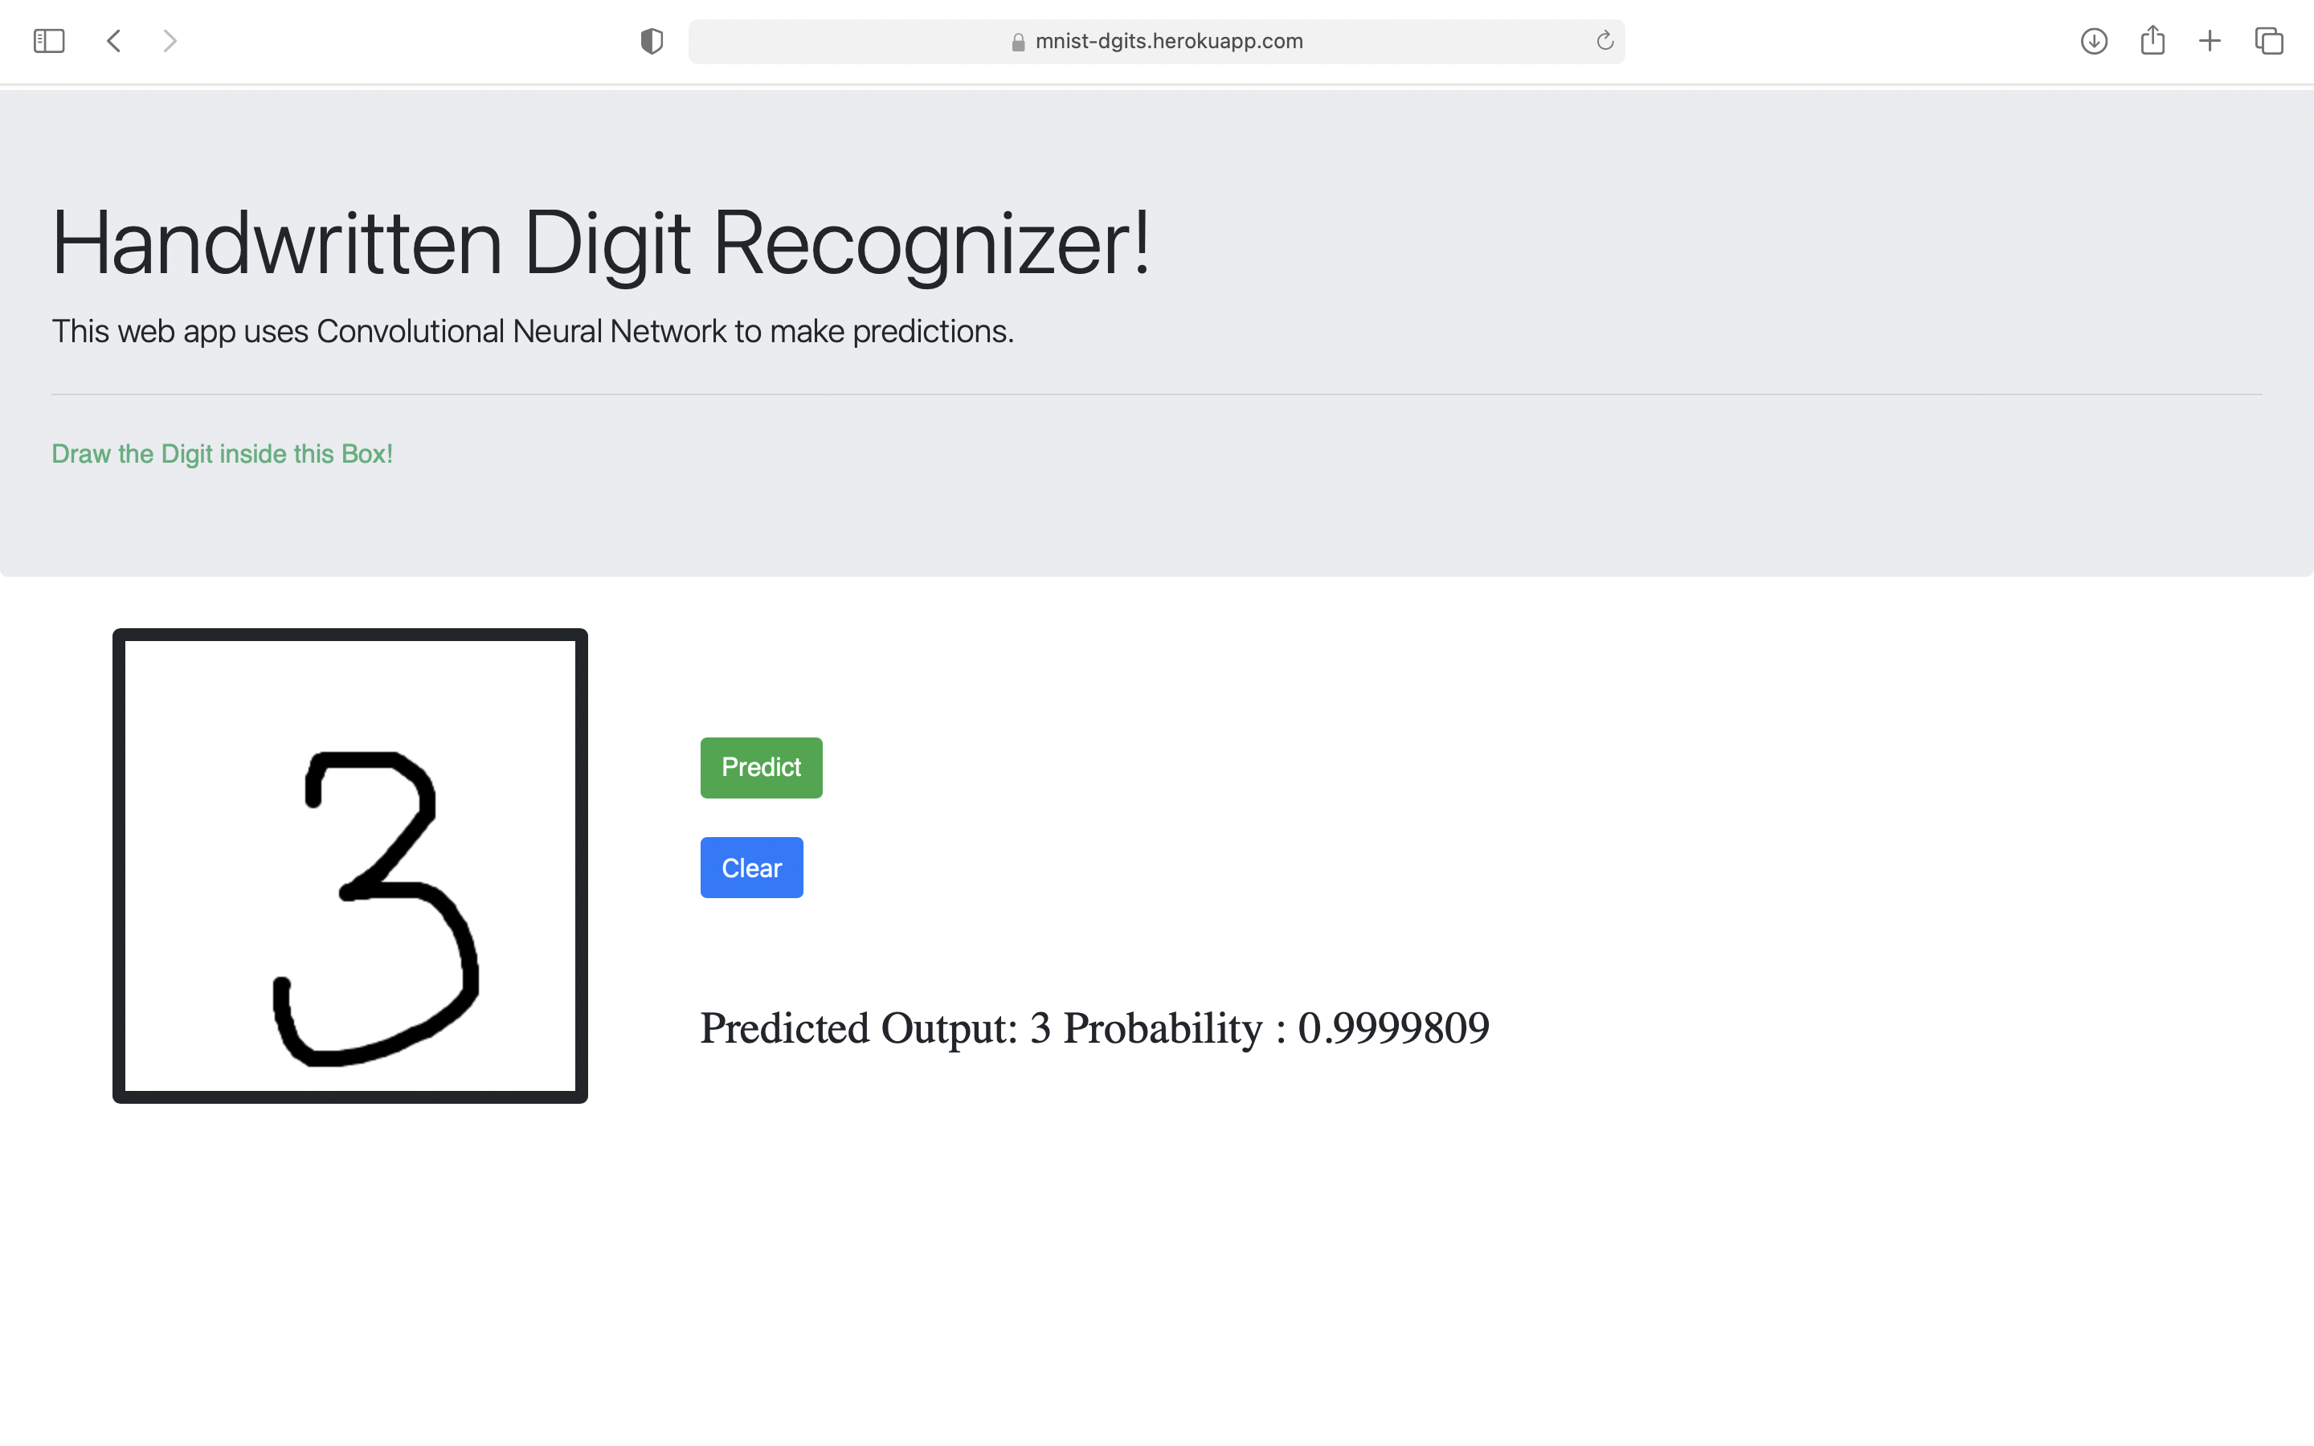
Department of Computer Science and Engineering

Slide 14
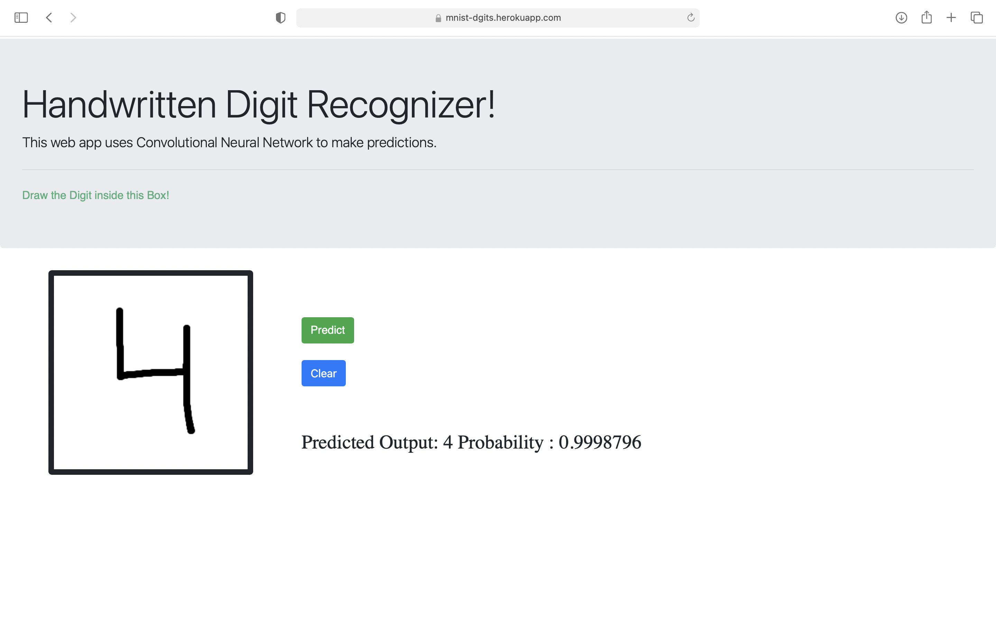
Department of Computer Science and Engineering

Slide 15
Options available to execute the project
Department of Computer Science and Engineering
Project deployment: https://mnist-dgits.herokuapp.com/
Project available on GitHub.

Slide 16
References
Department of Computer Science and Engineering
[1] V. Sharma, S. Rai, & A. Dev (2012). International Journal of Advanced Research in Computer Science and Software Engineering. Available: http://citeseerx.ist.psu.edu/viewdoc/download?doi=10.1.1.468.9353&rep=rep1&type= pdf
[2] G. Anbarjafari, “1. Introduction to image processing,” Sisu@UT. [Online]. Available: https://sisu.ut.ee/imageprocessing/book/1.
[3] P. Y. Simard, D. Steinkraus, & J. Platt. Best Practices for Convolutional Neural Networks Applied to Visual Document Analysis. Available: https://www.microsoft.com/en-us/research/publication/best-practices-for-convolutional-
neural-networks-applied-to-visual-document-analysis/?from=http%3A%2F%2Fresearch
[5] “MNIST database,” Wikipedia, 24-Apr-2018. [Online]. Available:
https://en.wikipedia.org/wiki/MNIST_database.

Slide 17
THANK YOU
Department of Computer Science and Engineering

